Slide 1


Sensor Development
Building a series of low-cost turbidity sensors for lab and field use.
https://aguaclara.github.io/sensor_dev/
Sensor Development | Fabrication | Symposium Presentation Fall 2020
Notes:
Kaleigh
Introductions: Winnie Chan, Payton Hunter, Kaleigh Soucy, Sanjana Uddin
Abstract: The Sensor Development sub team's goal is to develop a low-cost sensor and sludge judge with readily available materials to monitor and report water quality in the water treatment processes in AguaClara plants. In Fall 2020, the subteam plans to research and design a Sludge Judge Sampler, and continue prototyping and testing of a Dissolved Organic Sensor. The Dissolved Organic Sensor will act as a low-cost turbidimeter utilizing both the reflectance and absorbance of light.
Find our first report here:
[[https://github.com/AguaClara/sensor_dev/commit/088032eedb60f9d77470d3a1f85f0694bb2d3d15
]]

Slide 2
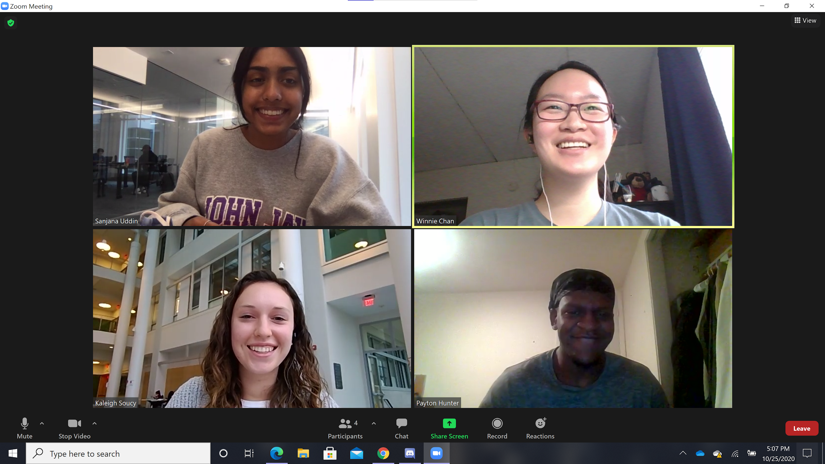
Meet the Team!
Sensor Development | Fabrication | Symposium Presentation Fall 2020
Notes:
Kaleigh

Slide 3
Overview
Sensor Development creates low-cost sensors to be used on-site and in lab for operators and researchers to gain insight into the processes of water treatment.
Sensor Development | Fabrication | Symposium Presentation Fall 2020
Notes:
Sanjana
Sensor Development works on many different types of sensors for both operators to use onsite in the plants and for researchers in the lab. Previously the team developed turbidity sensors for the HRS team and currently creates sensors for operators to check heights of sludge blankets as well as dissolved organic matter. The goal of sensor development is to gain insight into the various processes of the AguaClara water treatment process. This can then be used to then identify inefficiencies in the system.

Slide 4
About the Projects
Two ongoing projects:
Dissolved Organics Sensor
Stage: Prototyping
Sludge Judge Sampler
Stage: Research and Design
Sensor Development | Fabrication | Symposium Presentation Fall 2020
Notes:
Winnie and Sanjana
Sensor Dev is working on 2 projects - the dissolved organics sensor, and the sludge judge that took over the project of submersible sensor. Within dissolved organics sensor dev, we have made the casing for the LED and light sensor to be placed in to measure the sampled dissolved organics. We are currently setting up the IR sensor in order to run the experiment with varied concentrations of the dissolved sample. The stage of the sludge judge is currently research and design to determine the optimal approach to measuring the sludge blanket height.

Slide 5
Dissolved Organics Sensor
Dissolved Organics (DO) Sensor uses water samples from different stages in the plant in order to determine quantity of DO. Quantity then corresponds to coagulant that must then be added to remove particles from water.
Sensor Development | Fabrication | Symposium Presentation Fall 2020
Notes:
Sanjana
Context:
Gracias, Honduras
Yellow water because of decaying leaves.
Need an sensor for organic matter, but they are expensive.
Wavelength to be used - 254nm (ultraviolet light) - cheaper alternative is 450nm blue light.
Sensors that measure organic matter cost upwards of a thousand dollars. The goal of this project is to make that technology more affordable.
Dissolved organics are not always visible using a turbidity meter, so a specialized device would aid in detecting organic matter. We plan on developing a sample cell sensor to provide the functionality of a organic matter sensor at a much lower cost.

Slide 6
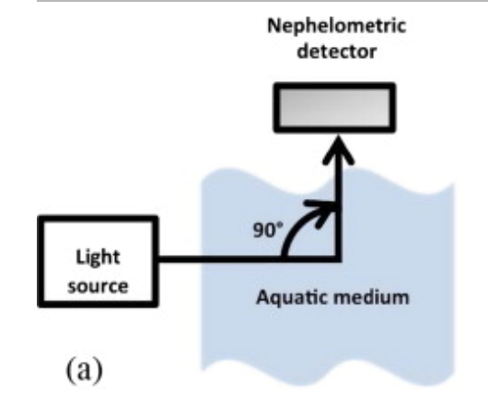
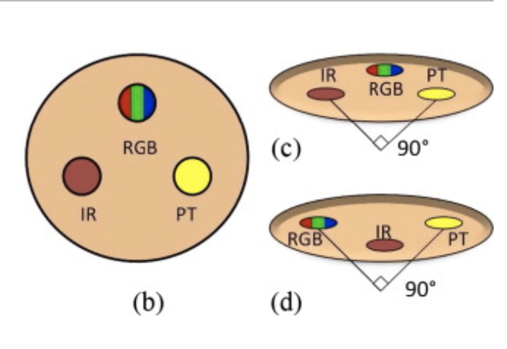
RGB and IR Sensor
Objective: Measure both the reflectance and absorbance of the light passing through the water by measuring light directly across and 90° from the light source.
Sensor Development | Fabrication | Symposium Presentation Fall 2020
Notes:
Sanjana:
The prior challenge of sensor development stemmed from the notion that dissolved organics are not always visible using a turbidity meter, so a specialized device was needed in order to aid the detection of the organic matter.
The solution that arose was the RGB and IR sensor, as it is a low-cost turbidimeter based on 90° scattering that provides information on both the color and identification of the sample dissolved particle. This was also an improvement from prior potential sensors: 245 nm sensor within the ultraviolet range (is more costly than light in the infrared region)
The above picture shows how the RGB sensor works. There is a transmission of light through the sample liquid and a detector that reads the light that is transmitted. The reason it is placed within a 90 degree angle is to take into account the possible variety of sizes of the solid dissolved particles. The particle size will taint the distribution of the scattered light, thus, placing the receiver in a 90 degree angle from the emitted would reduce that.
Furthermore, we have a sensor present 90 degrees from the light source in order to measure the light that was reflected, and a sensor parallel to the light source in order to measure the light that was absorbed.

Slide 7
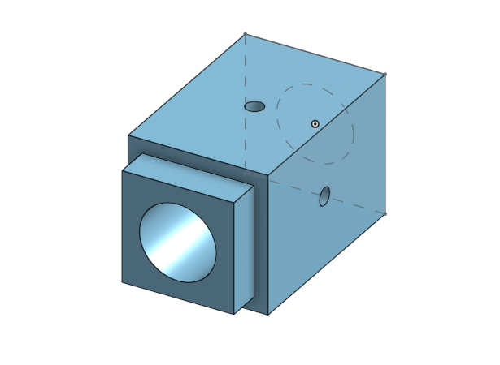
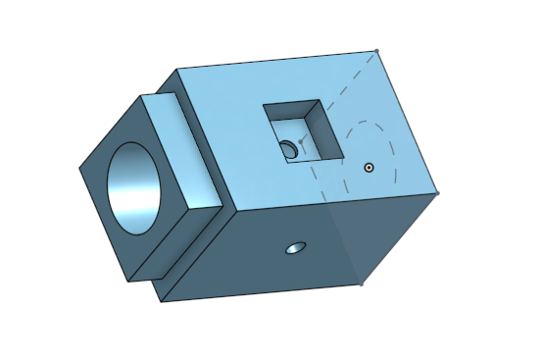
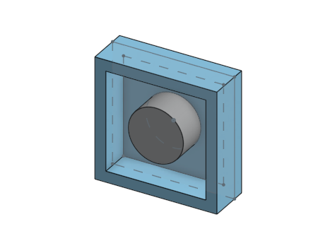
Low Cost Turbidity meter for Dissolved Organics
Figure: Casing for the sample-cell turbidity meter, with space for light sources and sensors on sides.
left to right: top cover for casing, casing for infrared sensor, casing for blue light sensor.
Sensor Development | Fabrication | Symposium Presentation Fall 2020
Notes:
Payton:
LED light produced from one end of the casing will go through a water sample to a light sensor. This will record the intensity of the transmitted light through the sample. Another sensor will be set up 90 degrees from the path of the produced light to record intensity of scattered light in the sample. At low turbidity the scattered light will also be low but will increase as the turbidity (NTU) increases. However at very high turbidity, there is a critical point where the scattered light will start to decrease. The transmitted light intensity will stay relatively the same at these high turbidites and the difference of the (Transmitted Light Intensity - Scattered Light Intensity) will give us the amount of dissolved organics in the sample. Dissolved organics and difficult to measure using solely transmitted light so the contrast of scattered light recording gives a more accurate measurement of the contents of the sample.
Sonu:
Two parts:
Blue light - would measure organic matter
IR light - would measure turbidity
Measuring the intensity at 90 degrees and directly across the source
Difference between the two readings → organic matter present in the sample
So far, we have prototyped the model for the sensor and 3D printed it to our specifications.
The next steps are to test the LEDs and the sensors.
The plan is to have a blue light source and a sensor across from each other.
The plan for the IR sensor is in the following slide

Slide 8
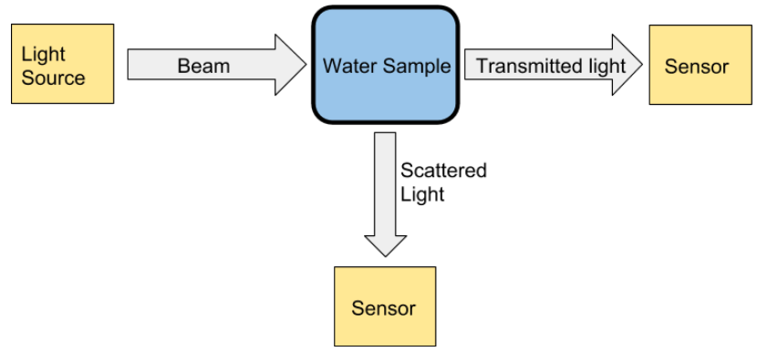
Model for the IR sensor
Sensor Development | Fabrication | Symposium Presentation Fall 2020
Notes:
Payton:
This model of the turbidimeter (determined in Spring 2019) will have two sensors - on directly across and another at 90 degrees from the light source. This will measure the light scattered by the particles at that angle.
As turbidity increases, the scattered light will increase and so, only some light will be transmitted. But at very high turbidity, the amount of scattered light will also decrease due to absorbance. However, the transmitted light would roughly be the same, due to limitations in measurement. Having the second sensor will help us get a better picture of the situation.
The implementation of this turbidimeter will lead to more accurate readings and analysis of the turbidity using the infrared sensors.

Slide 9
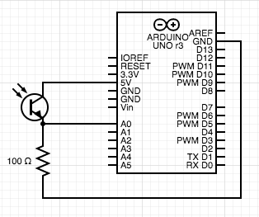
Circuit Diagram
NPN Phototransistor for sensing infrared light.
Sensor Development | Fabrication | Symposium Presentation Fall 2020
Notes:
Payton:
This is a circuit diagram for the IR phototransistor. The circuitry of the IR source is the same as that of the other project. The design has been consistent for multiple projects

Slide 10
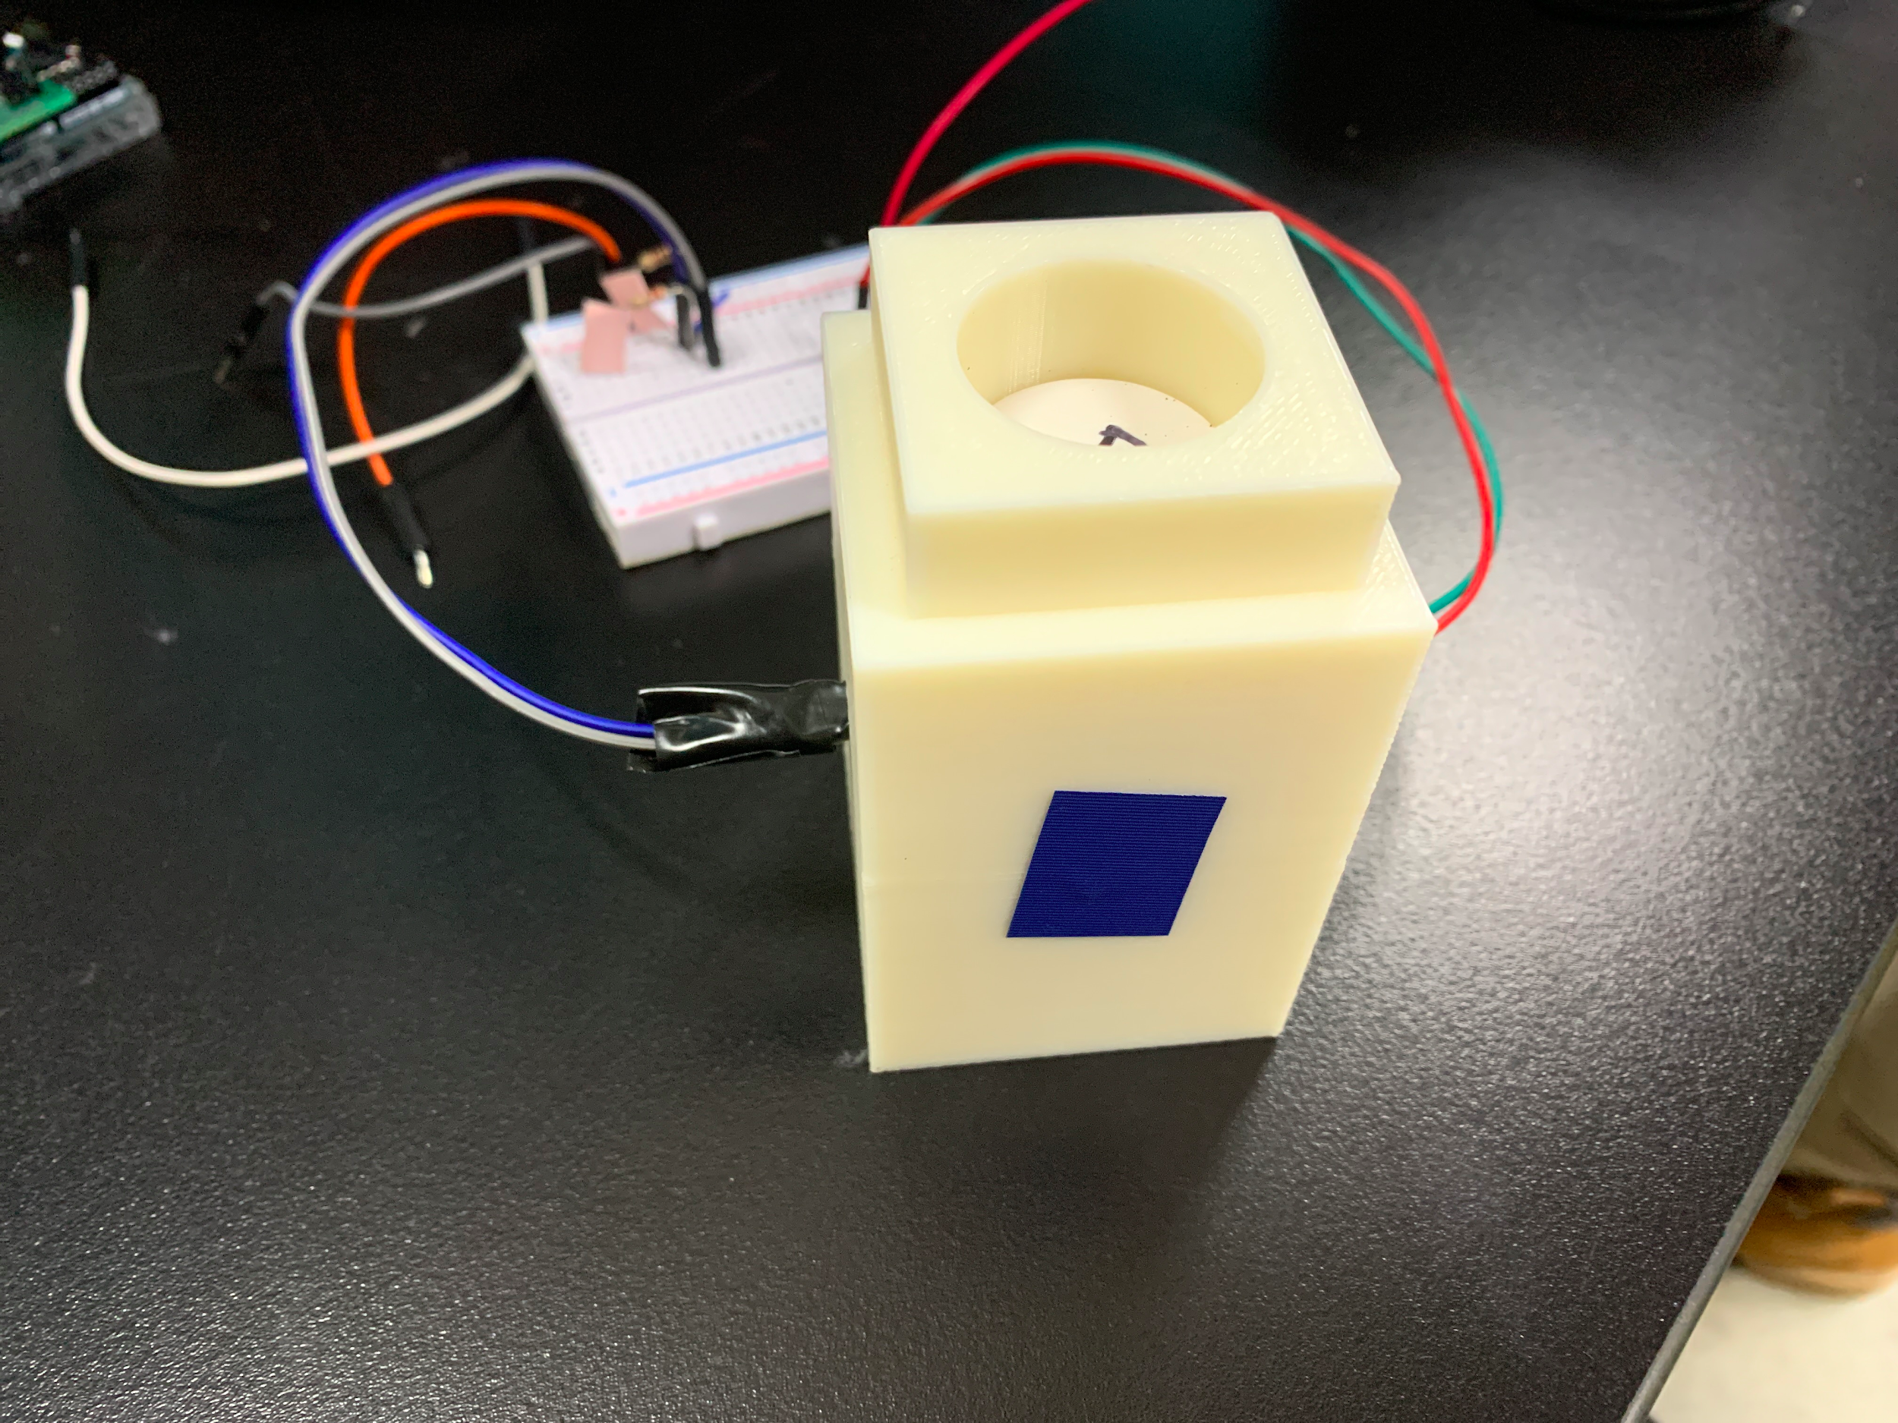
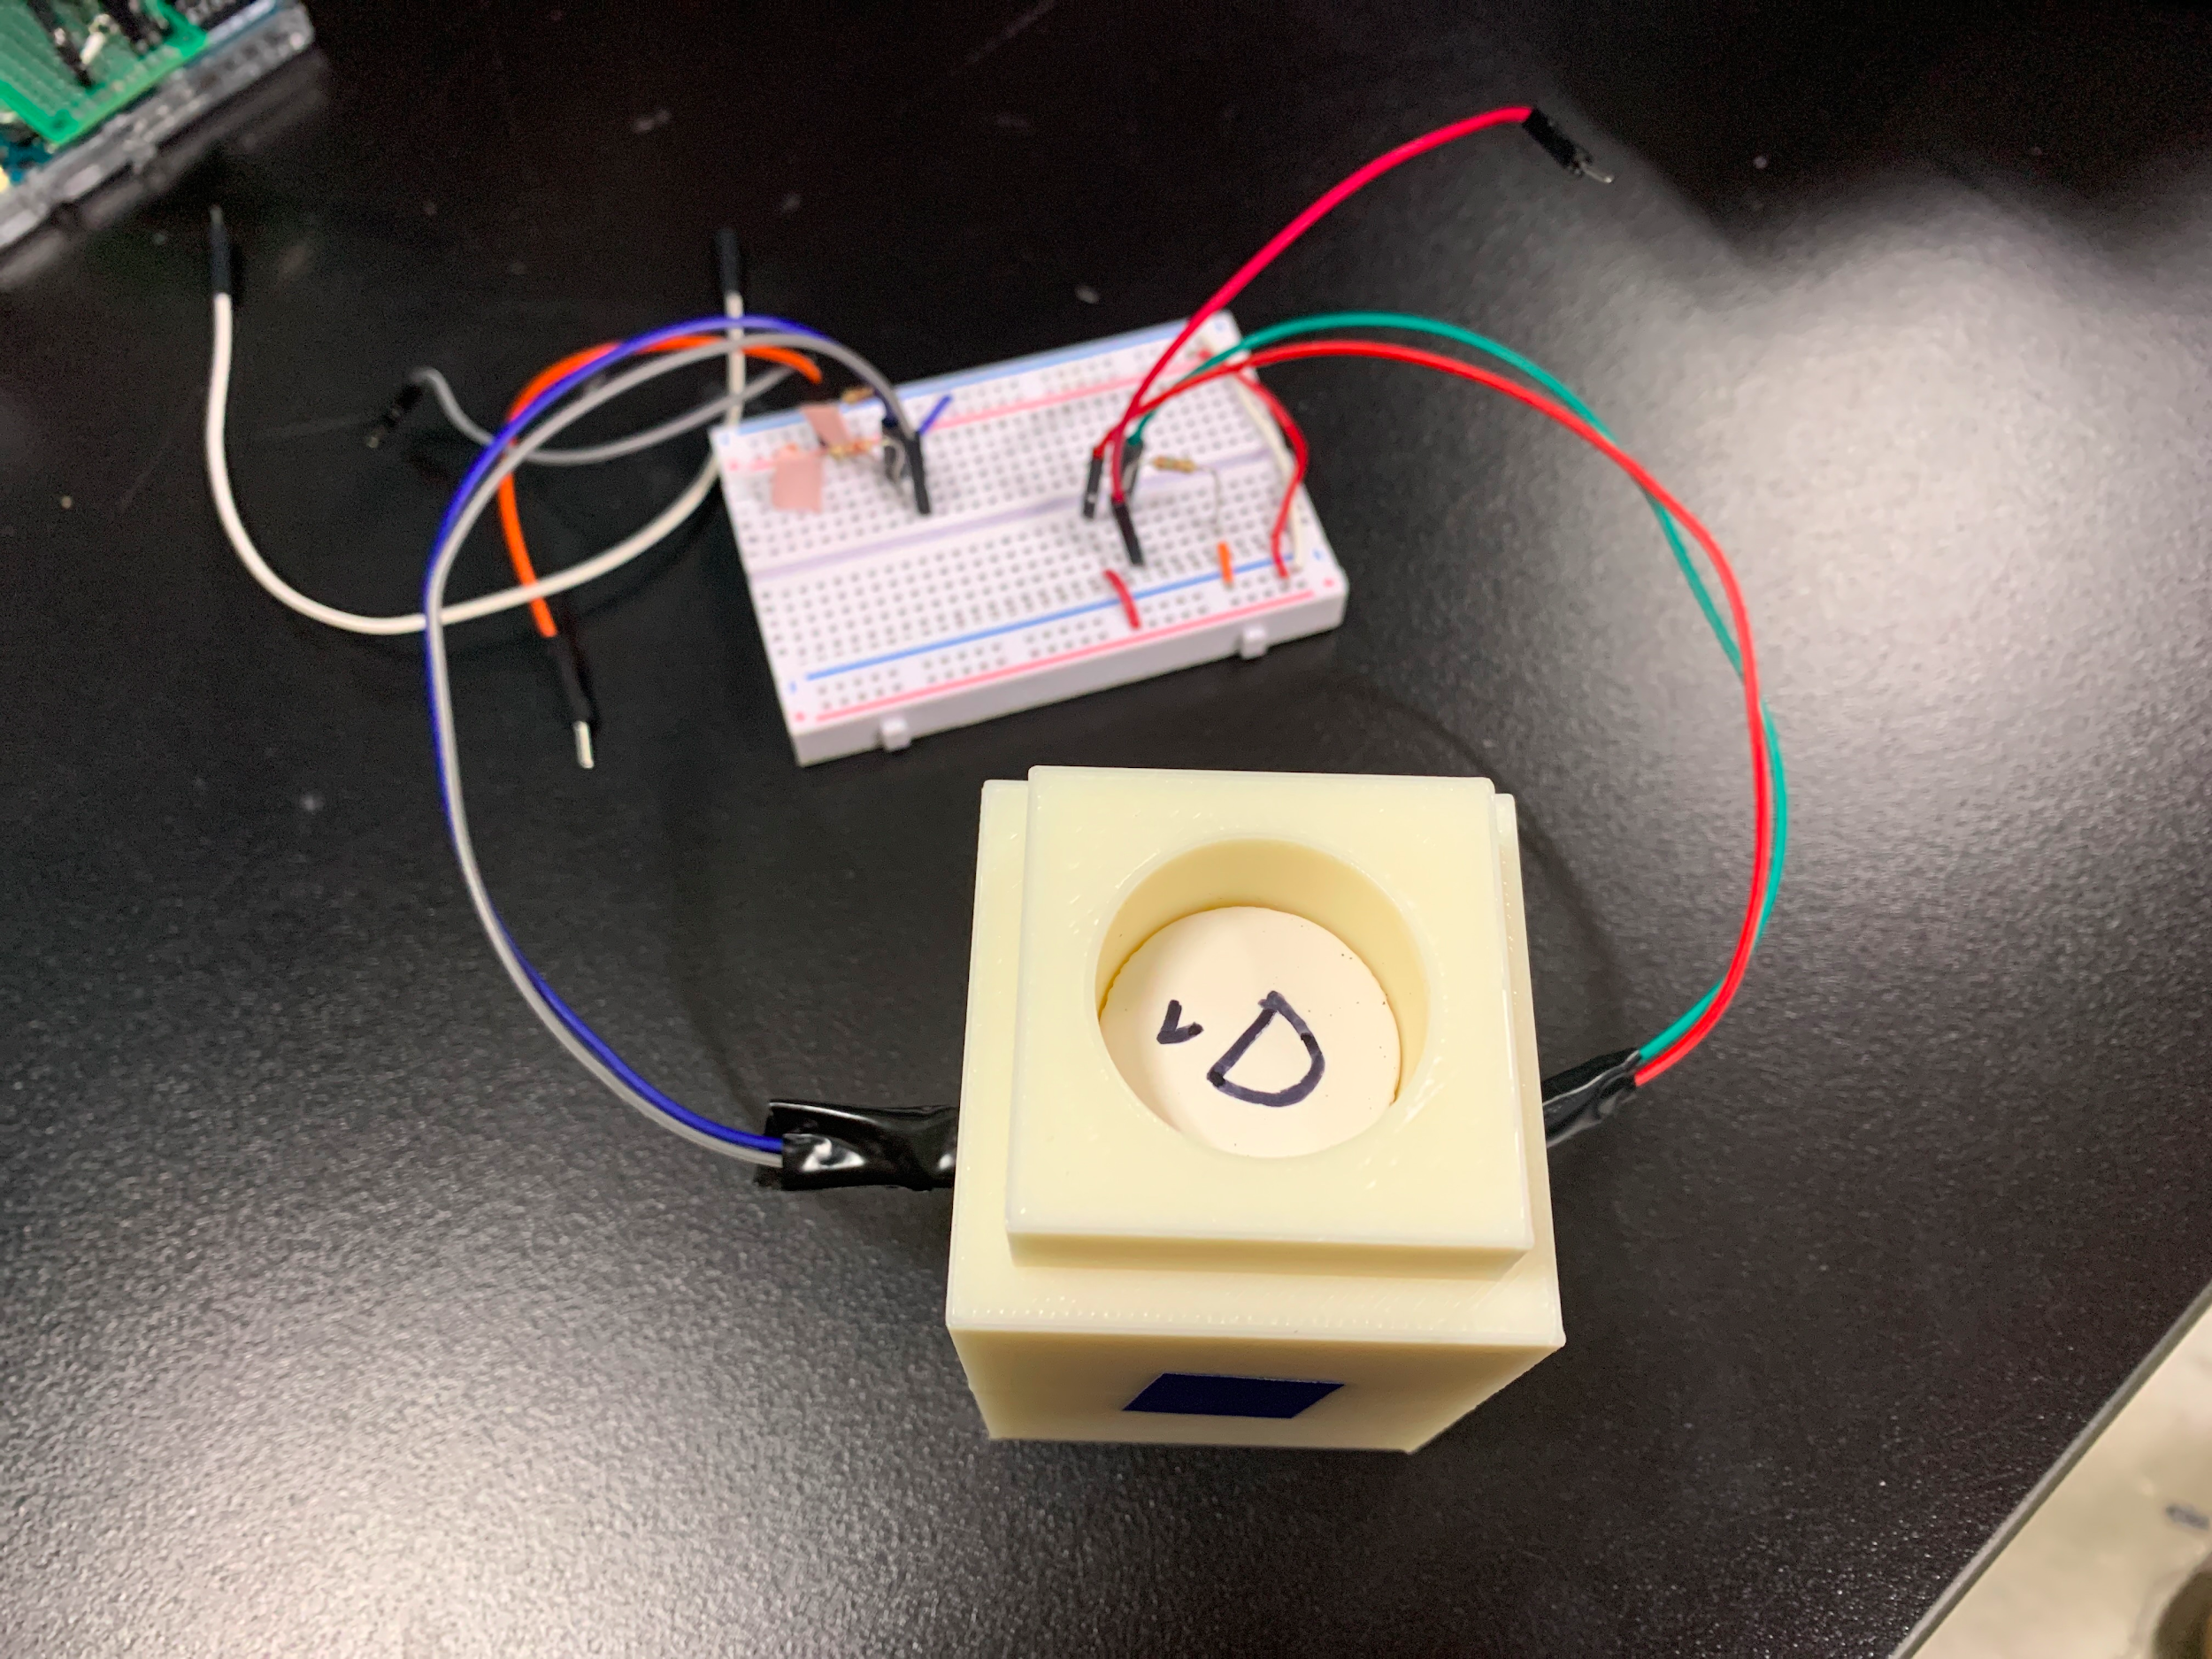
Testing Apparatus
Sensor Development | Fabrication | Symposium Presentation Fall 2020
Notes:
Payton:
Testing just for transmittance first (straight across)
Performed by inserting a vial of the water sample in the housing with the blue light source on one side and the sensor on another.
Similar setup for RGB sensor - just use the casing with the different

Slide 11
Sludge Judge
Sludge Judge will be used inside of the floc hopper in order to determine the sludge blanket height so that it can then be emptied, thus increasing efficiency of plant.
Sensor Development | Fabrication | Symposium Presentation Fall 2020
Notes:
Kaleigh
It is difficult for plant operators to track water quality inside the sedimentation tanks, especially to see the level of the sludge blanket in the tank, so that they can time tank cleanings. Pre-existing sensors and sludge judges on the market are too expensive and aren’t suited for the plant conditions, which is why the team is developing a sludge judge to perform this task at a lower cost and with the design constraints of the plant itself.
Sensors that measure organic matter cost upwards of a thousand dollars and sludge judges are between $100 and $200. Previously, the goal of this project was to make the sensor technology more affordable; however, the most cost effective and simplest approach would be to develop an affordable sludge judge apparatus.
We plan on researching and developing a sludge judge design that fits the sedimentation tanks’ parameters at a much lower cost than a traditional sludge judge and verify this apparatus will be most suitable for the plant’s floc hoppers.

Slide 12
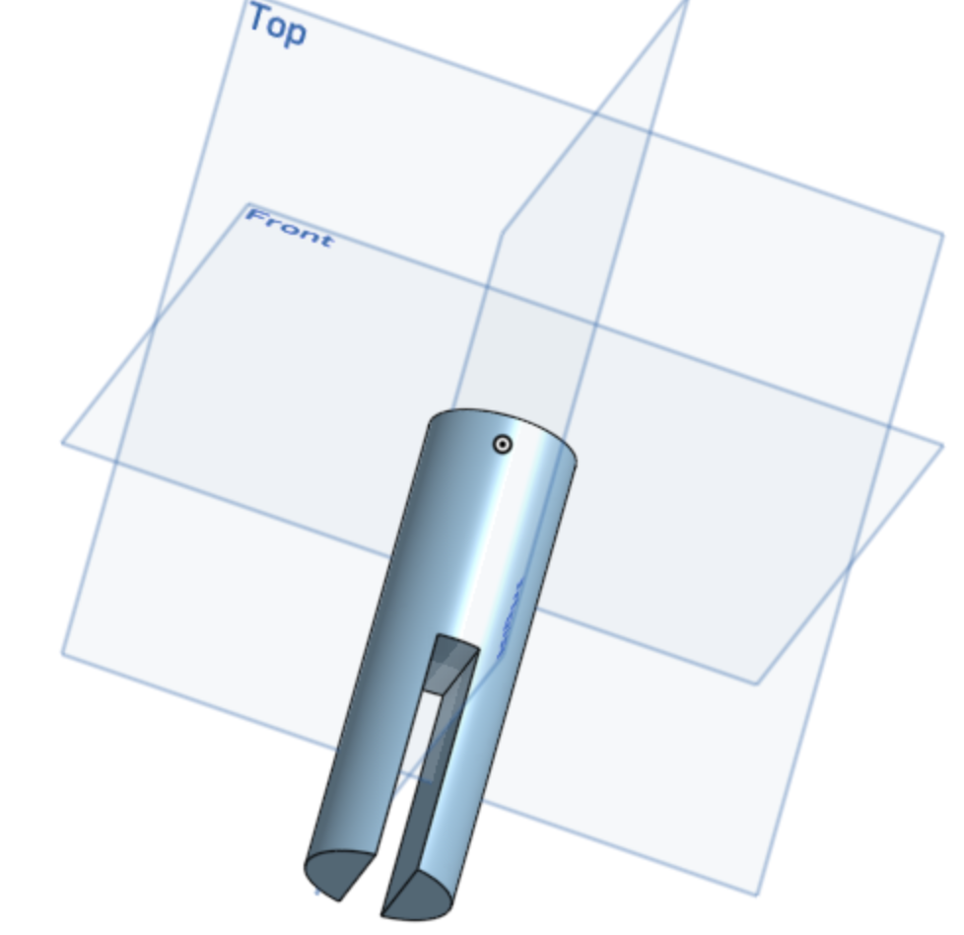
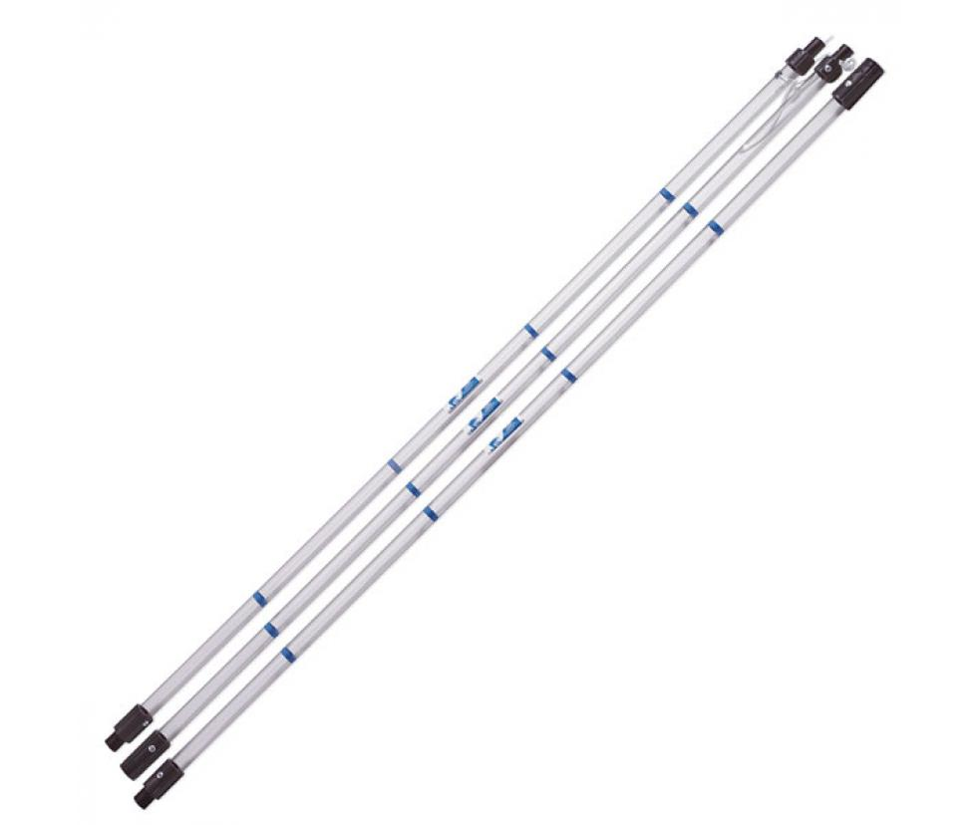
Sludge Blanket Measurement Tool (Old vs New)
Sensor Development | Fabrication | Symposium Presentation Fall 2020
Notes:
Kaleigh
Old vs New Model to detect sludge blanket height.
Image on the Left: previously designed sensor casing for a submersible sensor.
Image on the Right: Image of a market sludge judge which will be the foundation for the development of a new sludge judge design for the plants
Image from the company website: https://www.gogenlab.com/lab-supplies/sampling-supplies/sludge-judge-ultra-samplers/nasco-sludge-judge%C2%AE-ultra-super-strong
Improvements: Using a sludge judge eliminates the challenging of waterproofing a sensor. A sludge judge is also simple to use; therefore, little training is needed for operations
Challenges: Developing a design that doesn’t infringe on patent licenses

Slide 13
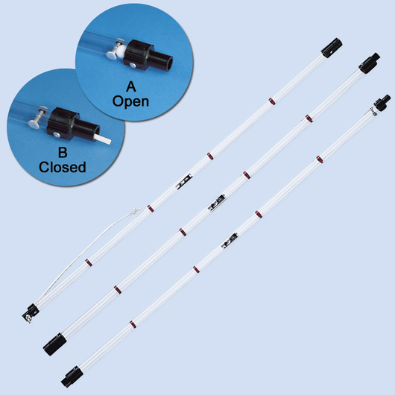
Market Sludge Judge (How it works)
Sensor Development | Fabrication | Symposium Presentation Fall 2020
Notes:
Winnie
Figure from: https://www.enasco.com/p/C09247WA
The tool enables one to take accurate readings on settled solids in a variety of liquids, to any depth.
The tool is made of connecting pieces of high impact plastic, a float and check valve, and a rope to hold/tug the pipe.
The tool is first lowered to the bottom of the tank one wants to sample. The float valve will open (configuration A).
When the bottom has been reached and the pipe has filled to the surface level, slightly tug on the rope as the unit is raised. This sets the check valve, trapping the column of solids and liquid in the pipe (configuration B.
When the unit has been raised out of the liquid, the amount of solids in the sample can be read using the increments marked on the pipe sections.
To release the material in the unit, touch the pin extending from the bottom section against a hard surface (see configuration B - the white pin). This opens the check valve to drain the sample in the pipe.

Slide 14
Future Tasks
Dissolved Organics Sensor
Set up the IR sensor.
Use sensor to measure the turbidity of samples with varying concentrations of clay dissolved in water.
Compare results to market turbidimeters and produce a calibration curve.
Sludge Judge
Conduct additional research on sludge judge usage in water treatment
Identify specific sludge judge parameters for the plants
Design a preliminary model of a sludge judge
Sensor Development | Fabrication | Symposium Presentation Fall 2020
Notes:
Winnie
For the Dissolved Organics Sensor, we need to set up the IR sensor and then use it to measure the turbidity of samples with varying concentrations of clay dissolved in water. In the previous semester, sample vials with different concentrations were already made and a market turbidimeter was used to measure turbidity. Our goal is to compare our recorded turbidity with those recorded by the market turbidimeter and to create a calibration curve based on that.
For the sludge judge, we need to conduct more research on sludge judges and determine the parameters of our design based on the aguaclara plants. Once we have more information, we can start designing a model of an affordable sludge judge.

Slide 15
Thank You
Winnie Chan
wc436@cornell.edu
Payton Hunter
prh64@cornell.edu
Kaleigh Soucy
krs258@cornell.edu
Sanjana Uddin
ssu3@cornell.edu
Sensor Development | Fabrication | Symposium Presentation Fall 2020
Notes:
Kaleigh
If there are any questions, please feel free to reach out to any of us on our emails. Thank you!

Slide 16
Appendix
Sensor Development | Fabrication | Symposium Presentation Fall 2020

Slide 17
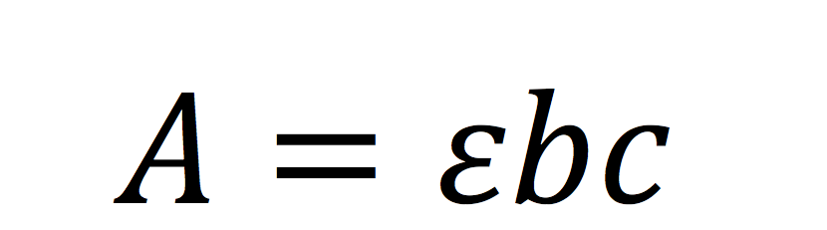
The Beer-Lambert Law was used to determine the relationship between concentration and absorbance.
where A = absorbance measured
ε = the wavelength-dependent molar absorptivity coefficient (1/M*cm)
b = the length of the path traveled by the light
c = concentration
Sensor Development | Fabrication | Symposium Presentation Fall 2020
Notes:
The Beer-Lambert Law states that absorbance is directly proportional to concentration. Taking the absorbance data from the sensors, these values can be converted to concentration/turbidity of the water using a experimentally determined relation that accounts for the molar absorptivity and the path length. This law forms the mathematical basis to our research and development of a calibration curve for the sensors.

Slide 18
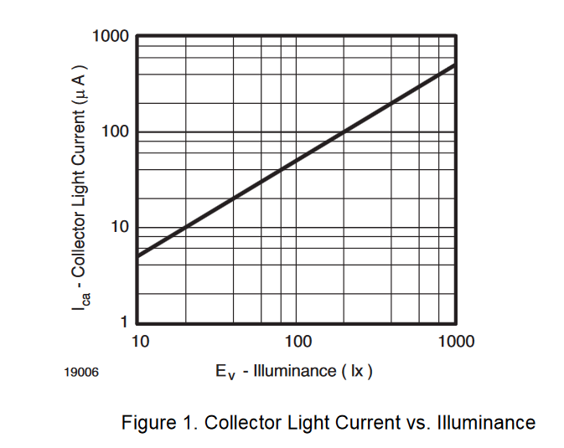
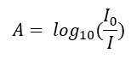
The absorbance is defined via the incident intensity (I0) and transmitted intensity I.
Sensor Development | Fabrication | Symposium Presentation Fall 2020
Notes:
The absorbance measured by the sensor is calculated using the formula A=log10(I0/I), where I0 is the intensity of the light source (initial intensity) and I is the intensity of the light that is transmitted through the turbid water. Light is diffracted as it travels through the fluid, resulting in a lowered intensity. This allows the absorbance to be calculated and then converted to concentration using the previously mentioned calibration curve.

Slide 19
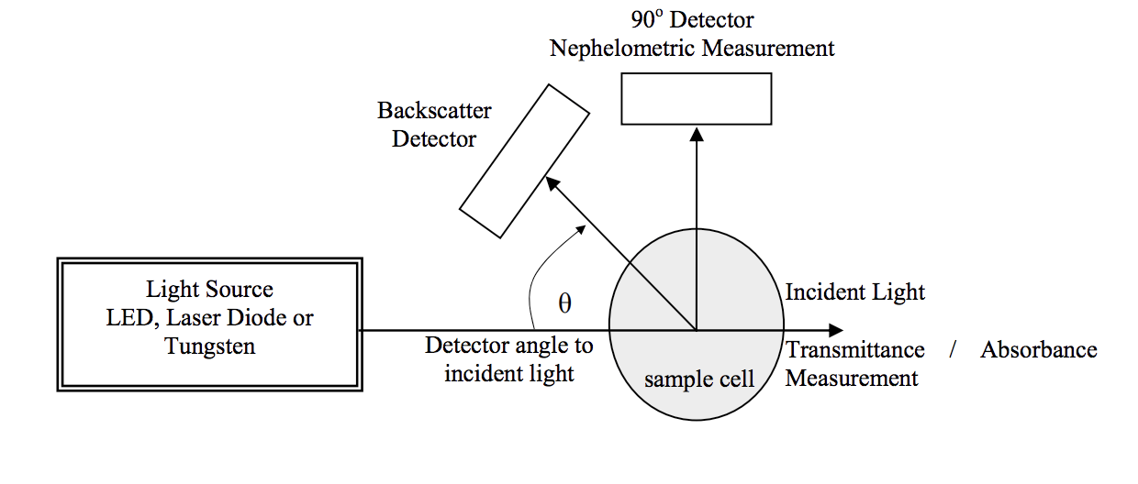
Turbidity sensors measure the scattering of light.
Turbidity sensors measure the light that is measured perpendicular to the emitted light source.
The more light is scattered towards the side, the higher the turbidity.
Sensor Development | Fabrication | Symposium Presentation Fall 2020
Notes:
Here is a paper that talks about the basic mechanisms behind turbidity sensors. Figure from paper:
www.mdpi.com/1424-8220/9/10/8311/pdf
Since we want to measure how many particles there are, one way we can do this is by emitting a constant light from one source and then measuring the light that can be read from a perpendicular standpoint. The more light can be read from the side means that there are more particles, since what originally would have been emitted in a forward direction is now being scattered to the sides. Using this measurement and other relations such as Beer-Lambert’s law such as outlined in the paper is how most commercial turbidity sensors work.

Slide 20
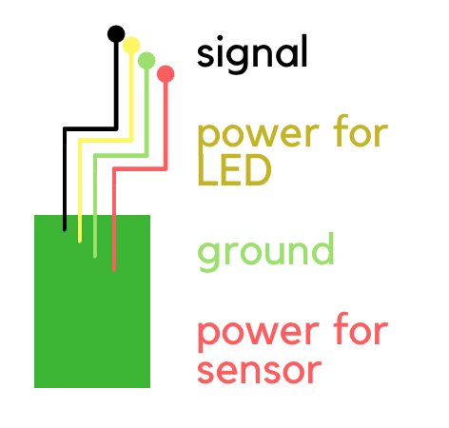
ProCoDA Board
The board that connects the sensors and LEDs to ProCoDA has 4 wires
GND
Signal (S)
Power for the sensor (V+)
Power for the LED (LED)
The team used female and male headers to make it simpler to connect the ProCoDA board to the sensor casing
Sensor Development | Fabrication | Symposium Presentation Fall 2020
Notes:
The figure shows the wiring for the ProCoDA board to the sensor, and explains the purpose of each wire.

